Slide 1

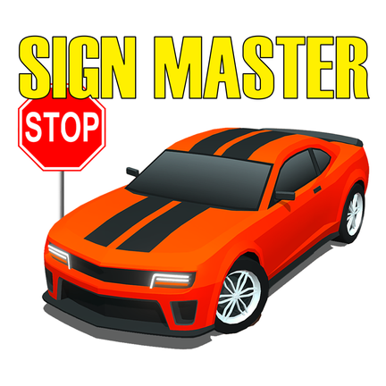

SIGN MASTER
LEARN TRAFFIC SIGNS WHILE GAMING
Subject: CD19651 - MINI PROJECT
(Project based on Gamification of Education)
Presented by:
Shyam Prasath R - 211701052
Venkatesh C - 211701059

Slide 2



OVERVIEW
Introduction
Objectives
Literature Review
Project Overview
Software Used
Game UI
Game Mechanics
Learning Objective
Future Scope
Conclusion

Slide 3

INTRODUCTION
"Sign Master" is an educational game designed to teach children about traffic signs in an engaging and interactive way.
It aims to enhance road safety awareness by helping children understand the importance of traffic signs and how to interpret them correctly.
Through the game, players embark on a virtual driving journey where they encounter various traffic signs commonly found on roads. They navigate through realistic road scenarios, complete quizzes, and challenges related to traffic signs, reinforcing their learning in a fun and immersive environment.

Slide 4
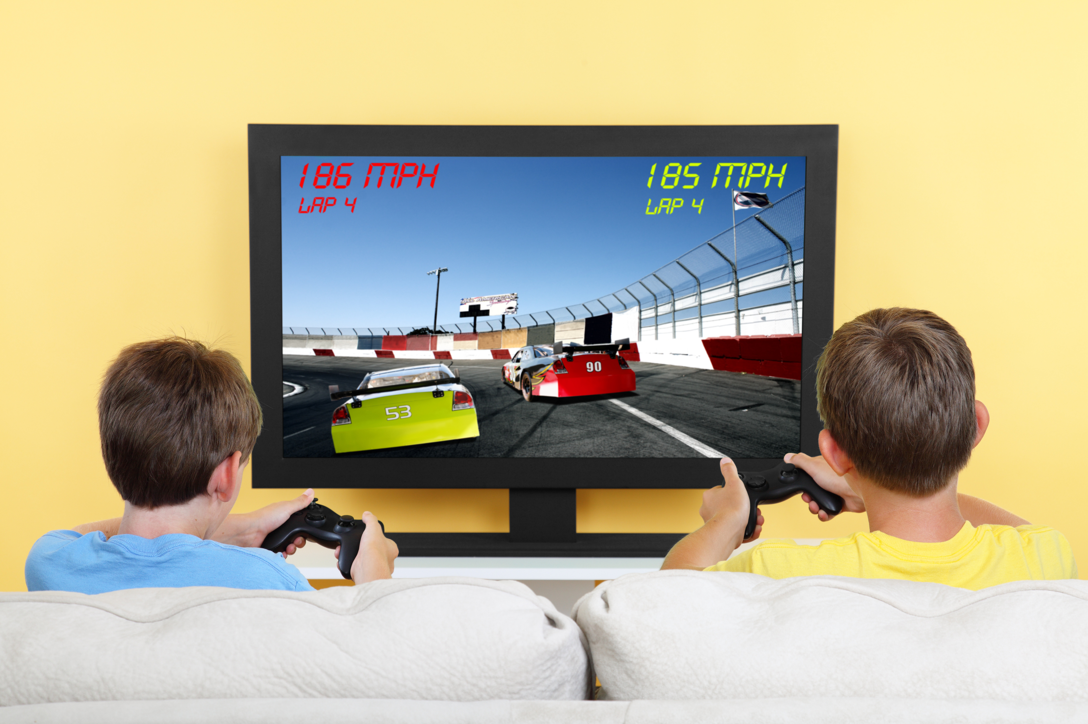
OBJECTIVES
Create an engaging educational game.
Enhance understanding of traffic signs.
Reinforce learning through interactive quizzes.
Utilize gamification principles.
Contribute to road safety awareness.

Slide 5
LITERATURE REVIEW
S.No. | Literature Paper | Literature summary | Limitations / Areas of Improvement required
1 | The Gamification of Learning: a Meta-analysis2 | This paper presents a meta-analysis of 44 studies on the effects of gamification on cognitive, motivational, and behavioral learning outcomes. | Adding interactive features and a game fiction to the to make our game more interactive and learn efficiently.
2 | Impact of Educational Games on Student Engagement and Learning Outcomes | The study evaluates the effectiveness of educational games in promoting active learning, problem-solving, and collaboration among students. Results suggest that educational games can enhance student motivation, engagement, and academic performance by providing interactive and experiential learning experiences. | However, the study underscores the importance of incorporating instructional support and scaffolding to facilitate meaningful learning and transfer of knowledge from games to real-world contexts.

Slide 6

LITERATURE REVIEW SUMMARY
The literature survey reveals the growing importance of gamification in education, highlighting its effectiveness in improving learner engagement, motivation, and knowledge retention. Studies demonstrate the potential of educational games to enhance cognitive skills, promote critical thinking, and facilitate practical application of learned concepts, making them valuable tools for modern education.

Slide 7

PROJECT OVERVIEW
"Sign Master" is an educational game that offers a virtual driving journey where players encounter various traffic signs commonly found on roads.
The game aims to provide a realistic environment for players to navigate through streets, intersections, and highways.
It incorporates interactive quizzes and challenges to reinforce learning and test players' knowledge of traffic signs.
The game utilizes gamification principles to promote active learning and retention among players.

Slide 8



SOFTWARES USED
Unity
Maya
Figma

Slide 9
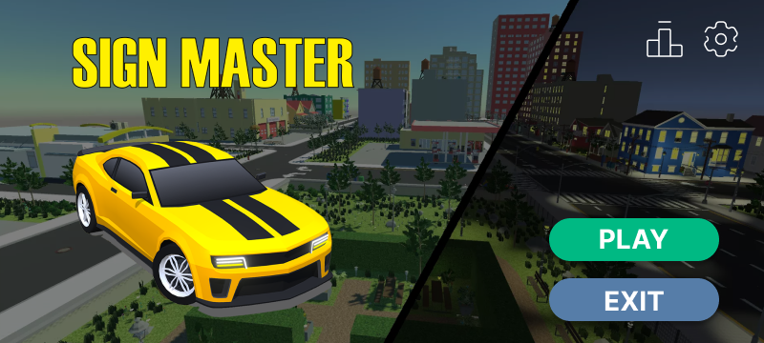

GAME UI

Slide 10
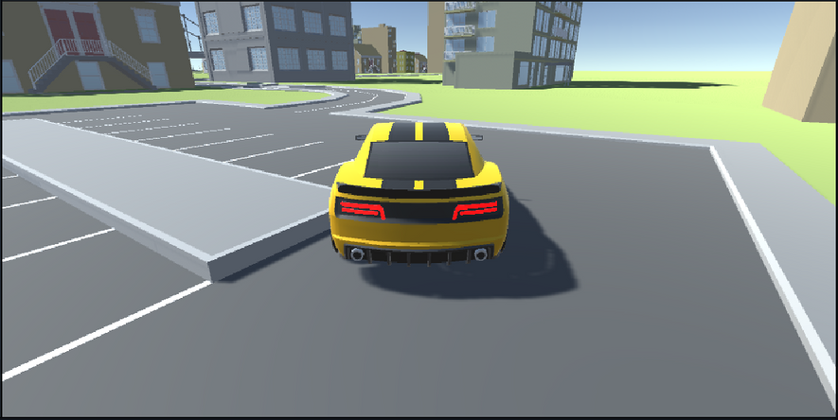
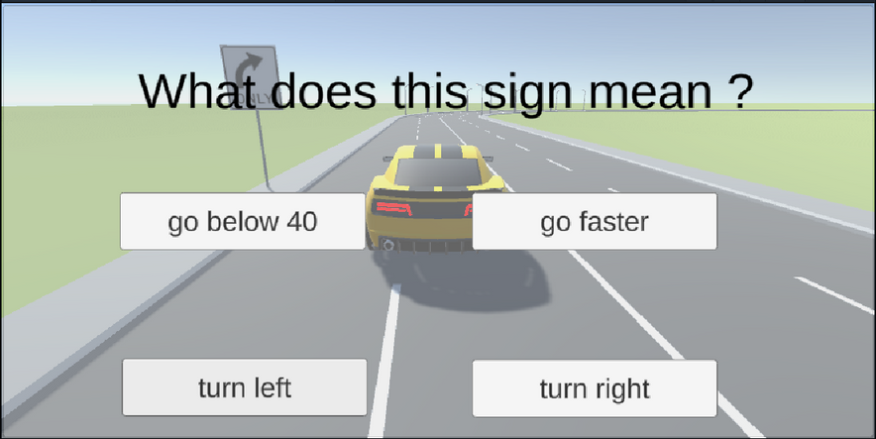
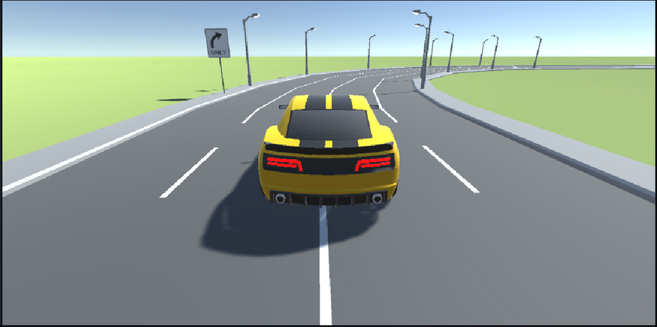
GAMEPLAY SCREENSHOTS

Slide 11

GAME MECHANICS
Players navigate through streets, intersections, and highways, encountering various traffic signs.
Interactive quizzes and challenges are integrated into the gameplay to reinforce learning.
Driving challenges add to the experience, testing players' knowledge and skills in a fun and engaging way.

Slide 12




LEARNING OBJECTIVES
The game aims to educate players about the importance of traffic signs and help them develop essential skills for navigating real-world traffic environments confidently.
Understand traffic signs
01
02
Interpretation of signs
03
Safe driving practices

Slide 13




FUTURE SCOPE
Augmented Reality (AR) or Virtual Reality (VR)
Gesture and Motion Controls
Machine Learning and Computer Vision

Slide 14



CONCLUSION
In conclusion, Sign Master represents an innovative approach to education by combining gamification with essential learning objectives related to traffic and industrial signs. By making learning fun, interactive, and rewarding, Sign Master aims to empower players with the knowledge and skills needed to navigate roads and industrial environments safely and confidently.

